Slide 1
TOEIC SPEAKING PRACTICE

Slide 2
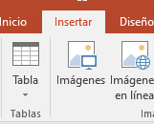
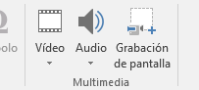
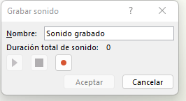
Recording an audio
Click on INSERT
Click on the AUDIO icon on the right side of the bar
Record Audio
Start recording

Slide 3
Questions 1–2: Read a text aloud
Directions: In this part of the test, you will read aloud the text on the screen. You will have 45 seconds to prepare. Then you will have 45 seconds to read the text aloud.

Slide 4
Text #1
Dave Billings worked for Bulb Village since 1986. He started in the accounting department, but the company transferred him to another office. The finance department experienced some changes, so he had to move again. Every department he worked in, like accounting, finance and sales, became more efficient. We are sad to see Dave Billings leave the company. However, we know that he will enjoy his retirement in Paris. We wish him “Bon Voyage!” There will be a retirement party this Friday at noon.
INSERT AUDIO HERE

Slide 5
Text #2
The personnel managers have decided to make staff changes in the finance, R&D and marketing departments. All of these transfers and promotions are designed to help the company become not only very big, but very efficient. The brand new job assignments will be available for viewing on Friday at four in the afternoon. The company will officially transfer employees on Monday, so please be ready to change your office by then. E-mail Paul Filler with any questions.
INSERT AUDIO HERE

Slide 6
Questions 3–4: Describe a picture.
Directions: In this part of the test, you will describe the picture on your screen in as much detail as you can. You will have 45 seconds to prepare your response. Then you will have 30 seconds to speak about the picture.

Slide 7
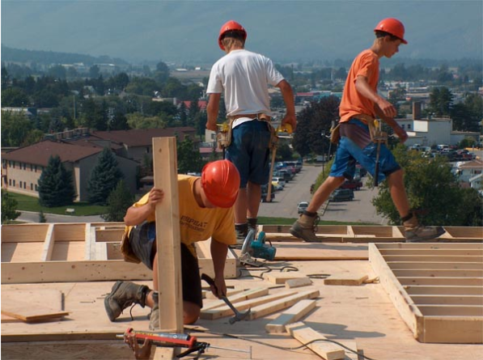
INSERT AUDIO HERE
30 Seconds

Slide 8
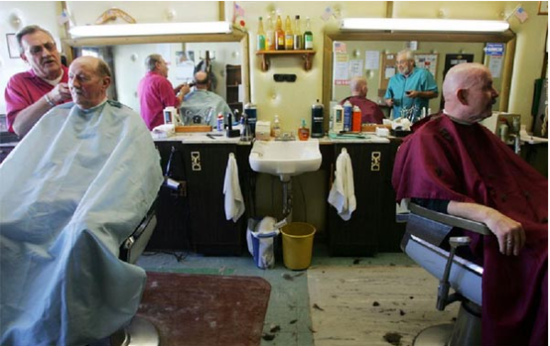
INSERT AUDIO HERE
30 Seconds

Slide 9
Questions 5–7: Respond to questions
Directions: In this part of the test, you will answer three questions. You will have 3 seconds to prepare before each question. Begin responding immediately after you hear a beep. You will have 15 seconds to respond to Questions 5 and 6, and you will have 30 seconds to respond to Question 7.

Slide 10
Imagine that you are talking to a new neighbor on the telephone. You are talking about live music in your area.
(5) What kind of music do you like to listen to, and do you listen to it often? 15 Seconds
(6) How often do you shop for music, and do you have a large collection of songs? 15 Seconds
(7) I'd like to buy some new music. Could you recommend a place for me to shop for music and tell me why you recommend it? 30 Seconds
INSERT AUDIOS HERE

Slide 11
Questions 8-10: Respond to questions using information provided
Directions: In this part of the test, you will answer three questions based on information provided. You will have 45 seconds to read the information before the question begins. You will have 3 seconds to prepare before each question. Begin responding immediately after you hear a beep. You will have 15 seconds to respond to Questions 8 and 9, and you will have 30 seconds to respond to Question 10.

Slide 12
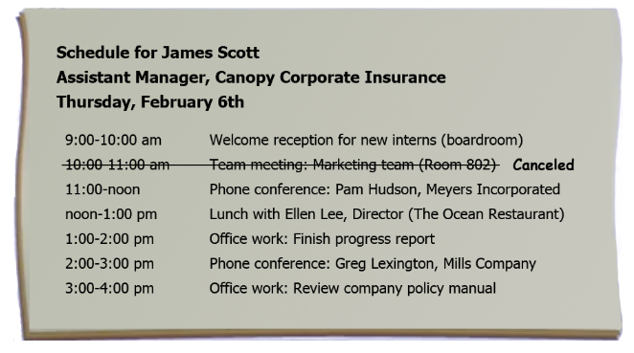

Slide 13

INSERT AUDIOS HERE
Question 8
15 seconds
Question 9
15 seconds
Question 10
30 seconds

Slide 14
Questions 11: Express and Opinion
Directions: In this part of the test, you will give your opinion about a specific topic. Be sure to say as much as you can in the time allowed. You will have 15 seconds to prepare. Then you will have 60 seconds to speak.

Slide 15
Which of the following is the BEST way for a high school student to improve the quality of its education? Choose ONE of the options provided below and give reasons or examples to support your opinion.
Provide more training to teachers
Offer more one-on-one instruction or tutoring
Give students more homework
INSERT AUDIO HERE
60 seconds

